Slide 1
Back to Software Traceability
Many traditional Software Traceability approaches rely on processes that “enforce” traceability
Through rigid processes - manual/automated linking of software artifacts at creation time or as part of quality assurance.
Through the use of document driven approaches
Question:
But how can we deal with traceability in agile development contexts, where documentation is of lesser importance or not available at all (e.g., agile processes, open source development)?

Slide 2

Mining Software Repositories
The following lecture notes are a subset of the notes available at:
http://ase.csc.ncsu.edu/dmse/

Slide 3
Mining Software Engineering Data
Ahmed E. Hassan Queen’s University www.cs.queensu.ca/~ahmed ahmed@cs.queensu.ca | Tao Xie North Carolina State University www.csc.ncsu.edu/faculty/xie xie@csc.ncsu.edu
Some slides are adapted from tutorial slides co-prepared by Jian Pei from Simon Fraser University, Canada
An up-to-date version of this tutorial is available at http://ase.csc.ncsu.edu/dmse/dmse-icse08-tutorial.pdf

Slide 4

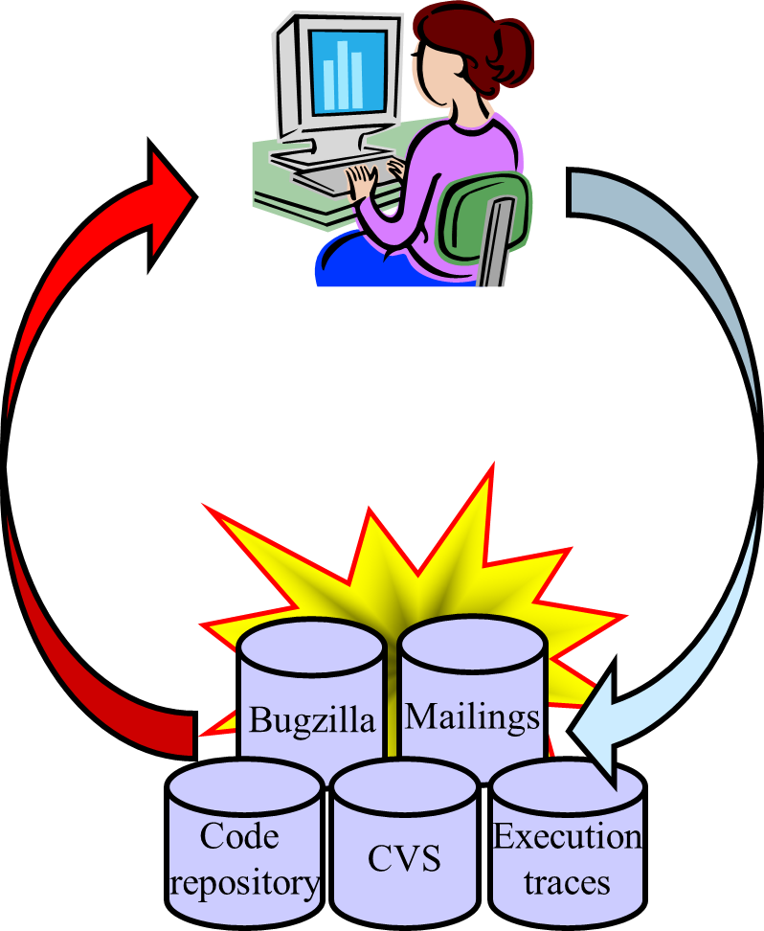
Mining SE Data
MAIN GOAL
Transform static record-keeping SE data to active data
Make SE data actionable by uncovering hidden patterns and trends

Slide 5
Mining SE Data
SE data can be used to:
Gain empirically-based understanding of software development
Predict, plan, and understand various aspects of a project
Support future development and project management activities

Slide 6
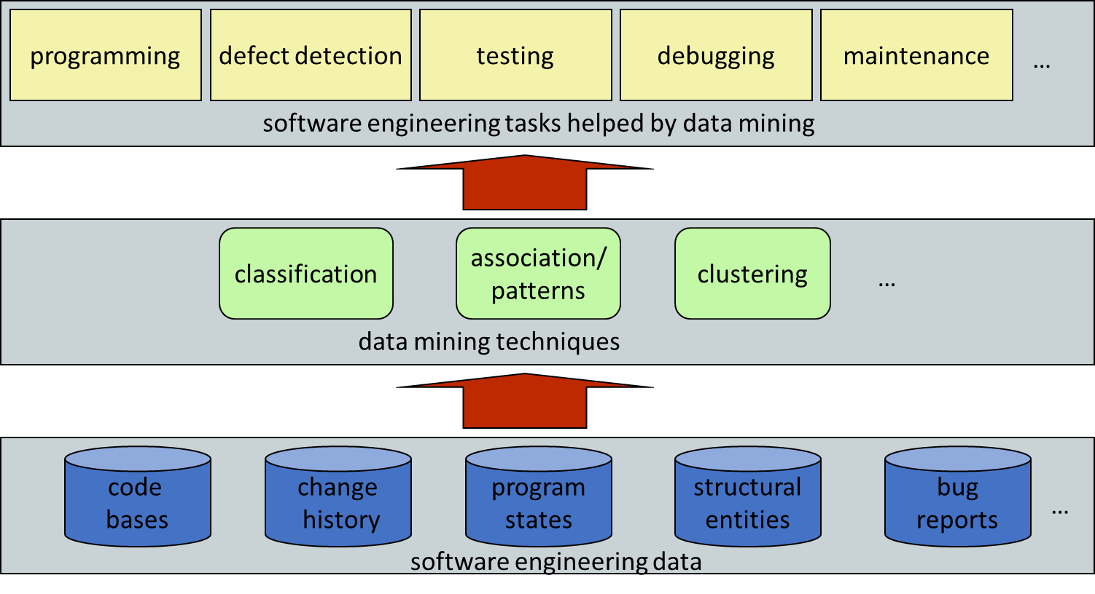
Overview of Mining SE Data

Slide 7

Types of SE Data
Historical data
Version or source control: cvs, subversion, perforce
Bug systems: bugzilla, GNATS, JIRA
Mailing lists: mbox
Multi-run and multi-site data
Execution traces
Deployment logs
Source code data
Source code repositories: sourceforge.net, google code

Slide 8

Historical Data
“History is a guide to navigation in perilous times. History is who we are and why we are the way we are.” - David C. McCullough

Slide 9
Historical Data
Track the evolution of a software project:
source control systems store changes to the code
defect tracking systems follow the resolution of defects
archived project communications record rationale for decisions throughout the life of a project
Used primarily for record-keeping activities:
checking the status of a bug
retrieving old code

Slide 10
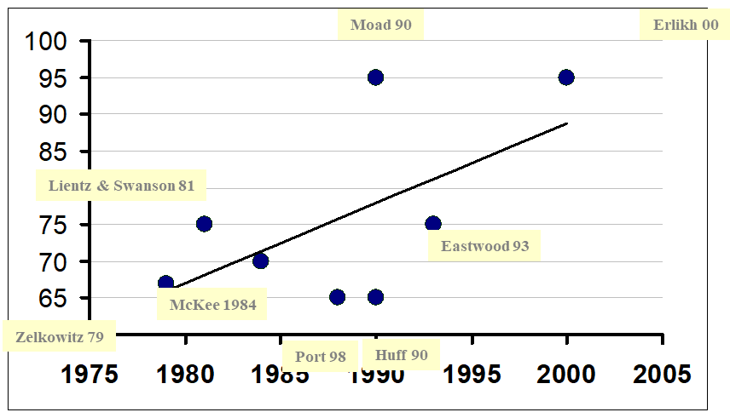
Percentage of Project Costs Devoted to Maintenance

Slide 11
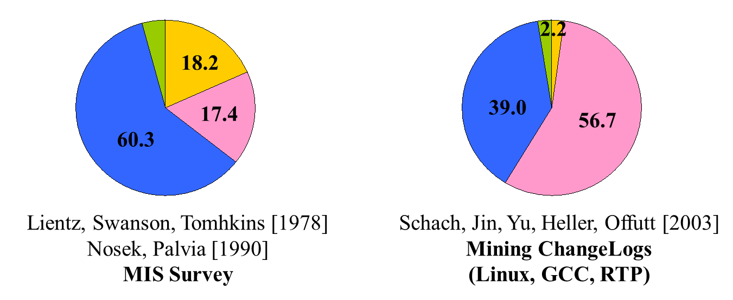
Survey of Software Maintenance Activities
Perfective: add new functionality
Corrective: fix faults
Adaptive: new file formats, refactoring

Slide 12
Source Control Repositories

Slide 13
Source Control Repositories
A source control system tracks changes to ChangeUnits
Example of ChangeUnits:
File (most common)
Function
Dependency (e.g., Call)
Each ChangeUnit:
Records the developer, change time, change message, co-changing Units

Slide 14
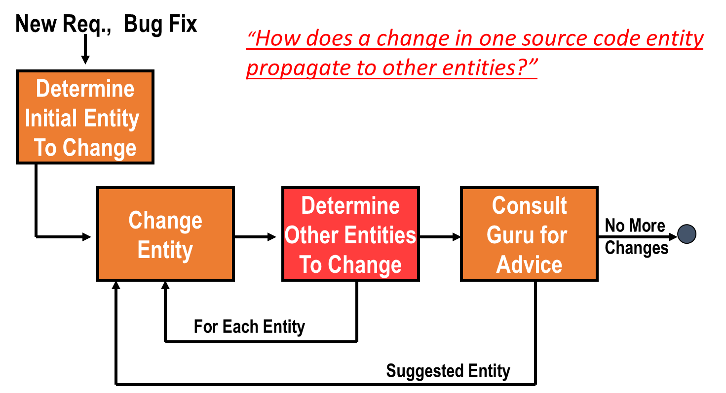
Change Propagation

Slide 15
Guiding Change Propagation
Mine association rules from change history
Use rules to help propagate changes:
Recall as high as 44%
Precision around 30%
High precision and recall reached in < 1mth
Prediction accuracy improves prior to a release (i.e., during maintenance phase)
[Zimmermann et al. 05]

Slide 16

Code Sticky Notes
Traditional dependency graphs and program understanding models usually do not use historical information
Static dependencies capture only a static view of a system – not enough detail!
Development history can help understand the current structure (architecture) of a software system
[Hassan & Holt 04]

Slide 17
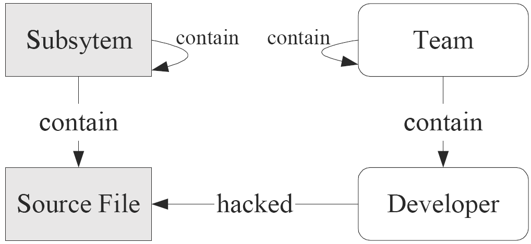
Studying Conway’s Law
Conway’s Law:
“The structure of a software system is a direct reflection of the structure of the development team”
[Bowman et al. 99]

Slide 18
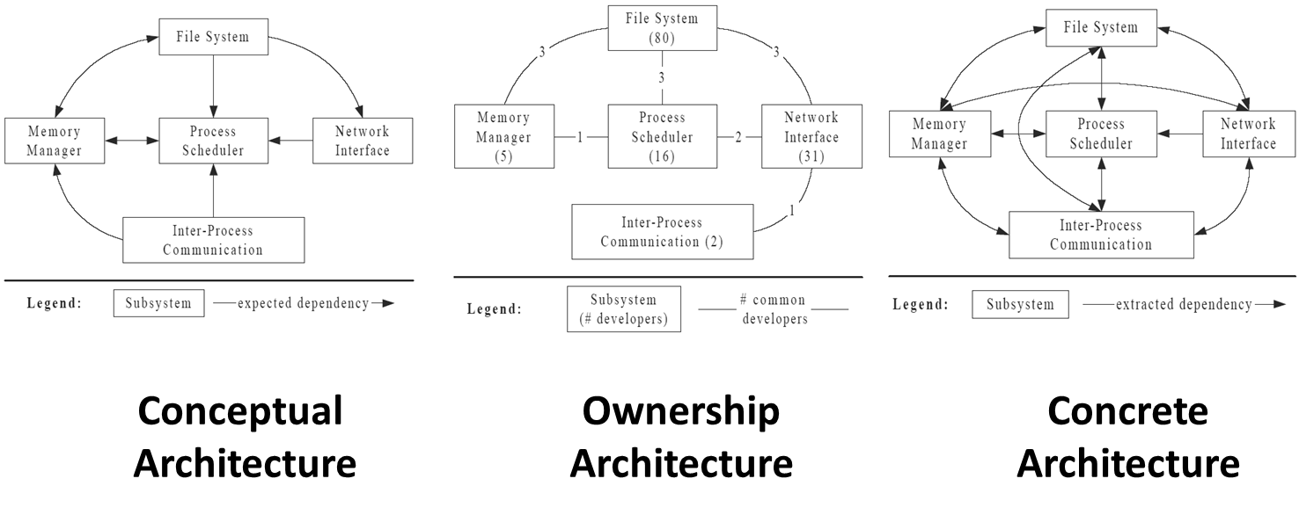
Linux: Conceptual, Ownership, Concrete

Slide 19
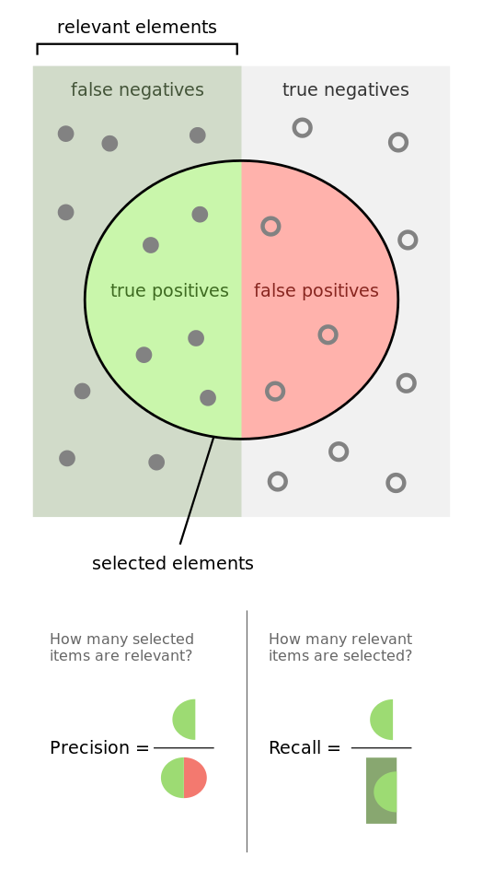


Measuring Quality of Mining approach
We want:
High Precision to avoid wasting time
High Recall to avoid bugs

Slide 20
Source Control and Bug Repositories

Slide 21
Predicting Bugs
Studies have shown that most complexity metrics correlate well with LOC!
Graves et al. 2000 on commercial systems
Herraiz et al. 2007 on open source systems
Noteworthy findings:
Previous bugs are good predictors of future bugs
The more a file changes, the more likely it will have bugs in it
Recent changes affect more the bug potential of a file over older changes (weighted time damp models)
Number of developers is of little help in predicting bugs
Hard to generalize bug predictors across projects unless in similar domains [Nagappan, Ball et al. 2006]

Slide 22
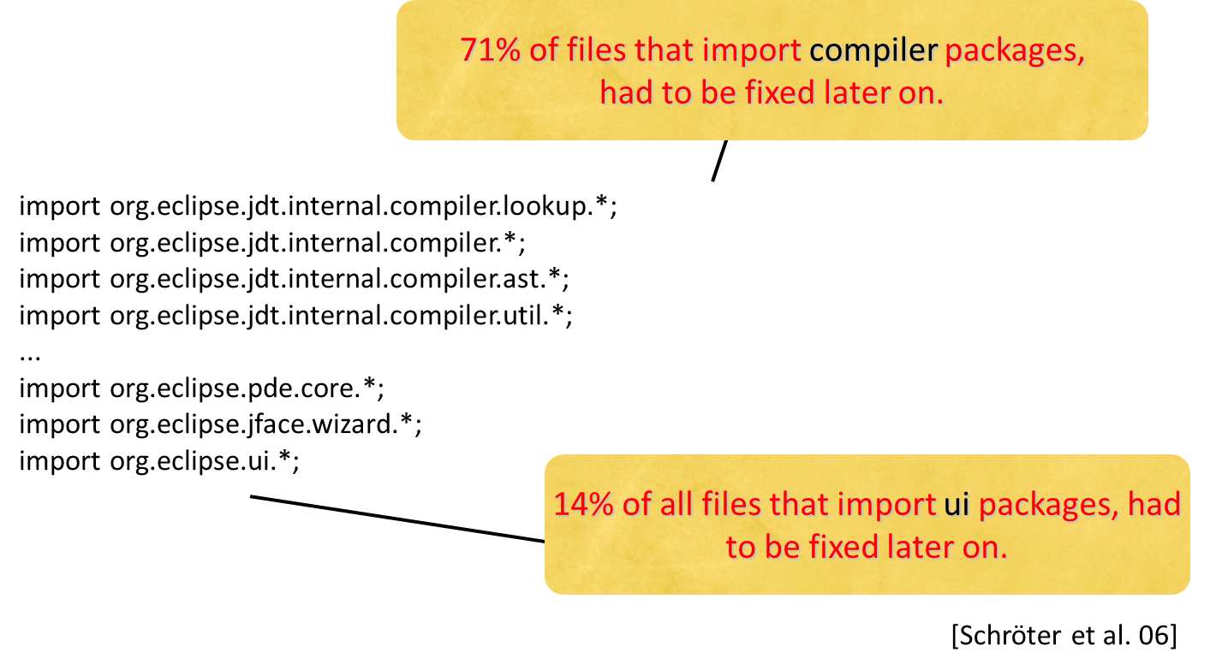
Using Imports in Eclipse to Predict Bugs

Slide 23
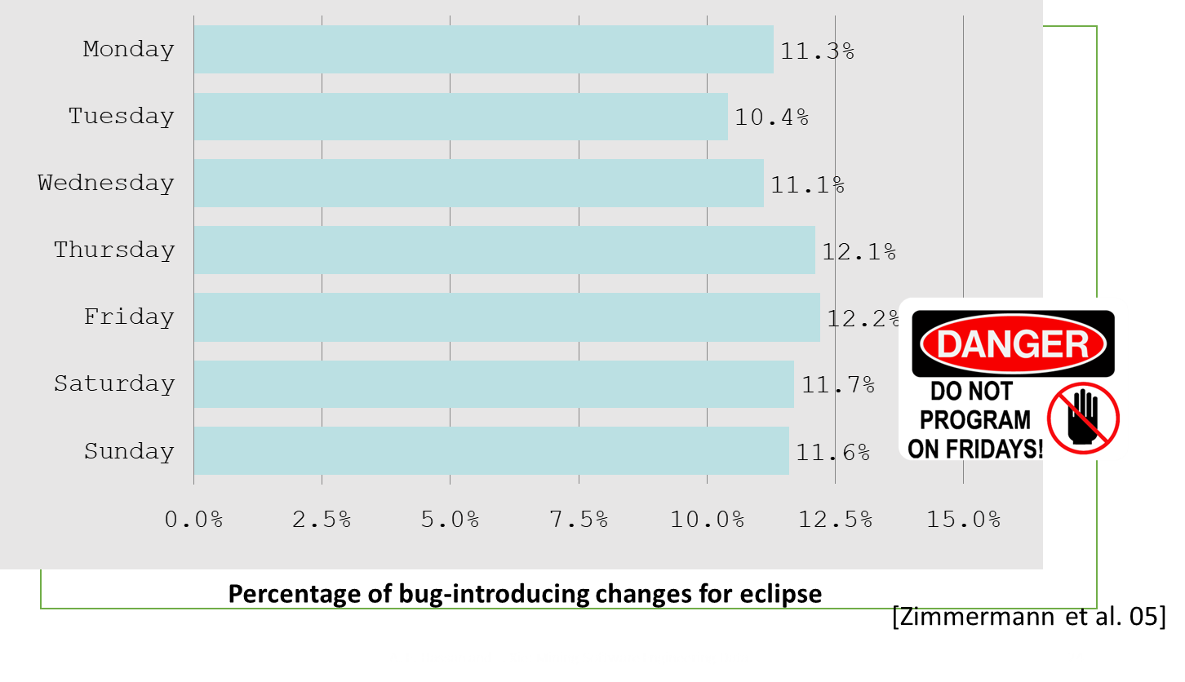
Don’t program on Fridays ;-)

Slide 24

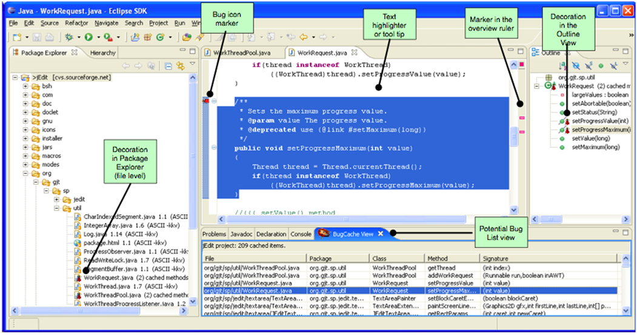
Classifying Changes as Buggy or Clean
Given a change can we warn a developer that there is a bug in it?
Recall/Precision in 50-60% range
[Sung et al. 06]

Slide 25

Project Communication – Mailing lists

Slide 26
Project Communication (Mailinglists)
Most open source projects communicate through mailing lists or IRC channels
Rich source of information about the inner workings of large projects
Discussions cover topics such as future plans, design decisions, project policies, code or patch reviews
Social network analysis could be performed on discussion threads

Slide 27
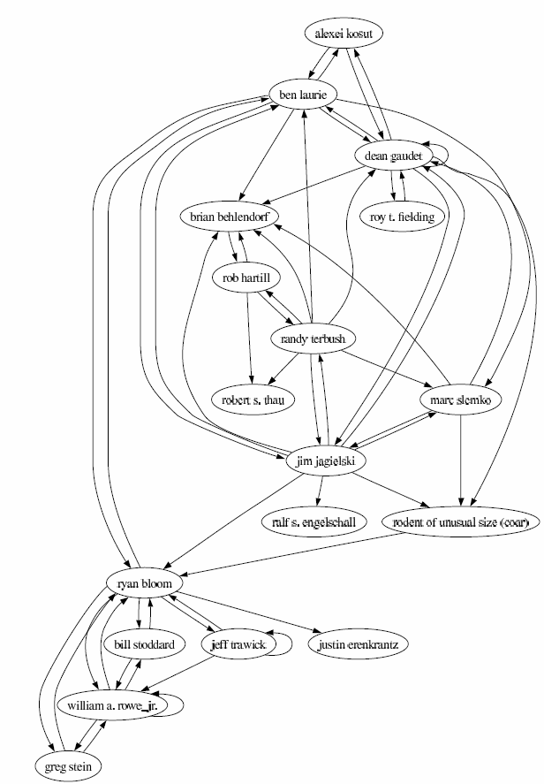
Social Network Analysis
Mailing list activity:
strongly correlates with code change activity
moderately correlates with document change activity
Social network measures (in-degree, out-degree, betweenness) indicate that committers play a more significant role in the mailing list community than non-committers
[Bird et al. 06]

Slide 28

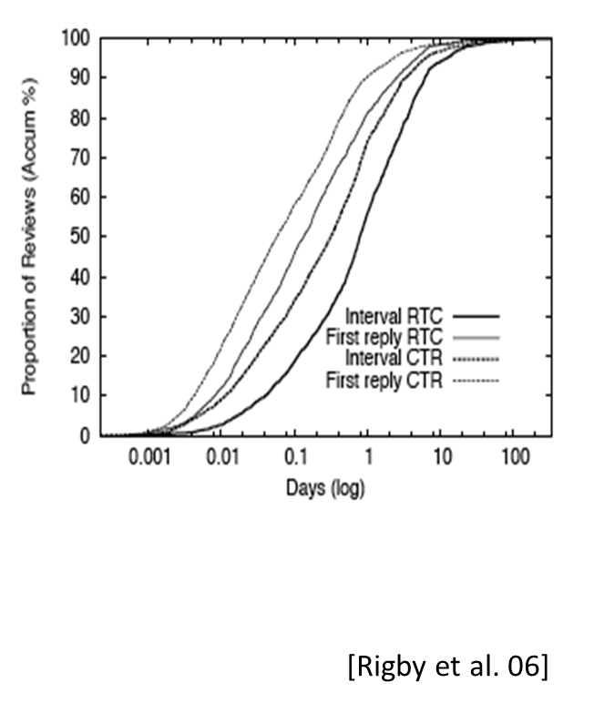
The Patch Review Process
Two review styles
RTC: Review-then-commit
CTR: Commit-then-review
80% patches reviewed within 3.5 days and 50% reviewed in <19 hrs

Slide 29
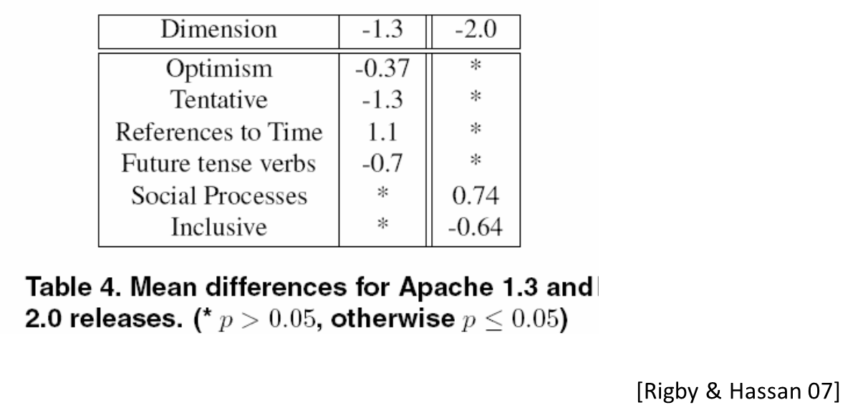
Measure a team’s morale around release time?
Study the content of messages before and after a release
Use dimensions from a psychometric text analysis tool:
After Apache 1.3 release there was a drop in optimism
After Apache 2.0 release there was an increase in sociability

Slide 30
Program Source Code

Slide 31
Code Entities
Source data | Mined info
Variable names and function names | Software categories [Kawaguchi et al. 04]
Statement seq in a basic block | Copy-paste code [Li et al. 04]
Set of functions, variables, and data types within a C function | Programming rules [Li&Zhou 05]
Sequence of methods within a Java method | API usages [Xie&Pei 05]
API method signatures | API Jungloids [Mandelin et al. 05]

Slide 32
Program Execution Traces

Slide 33
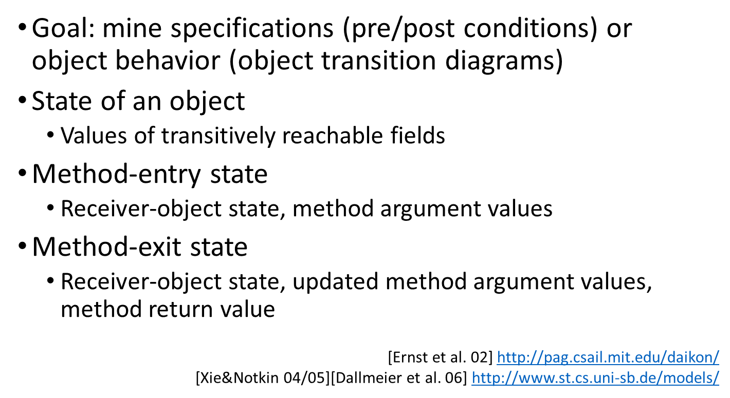
Method-Entry/Exit States

